Slide 1
Competitive Programming
11 Nov. 2023
Andrei Novikov

Slide 2

Practice on BAPC 2019 (preliminaries)
What is BAPC?
Benelux Algorithm Programming Contest
Is there tasks on any practice engine?
Kattis – Link
Where to find tasks and other information?
BAPC official web-site – Link

Slide 3
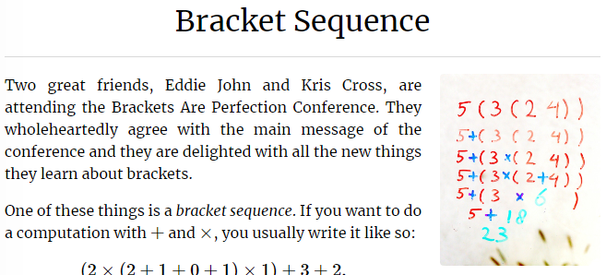
Bracket Sequence
Kattis. Bracket Sequence – Link

Slide 4
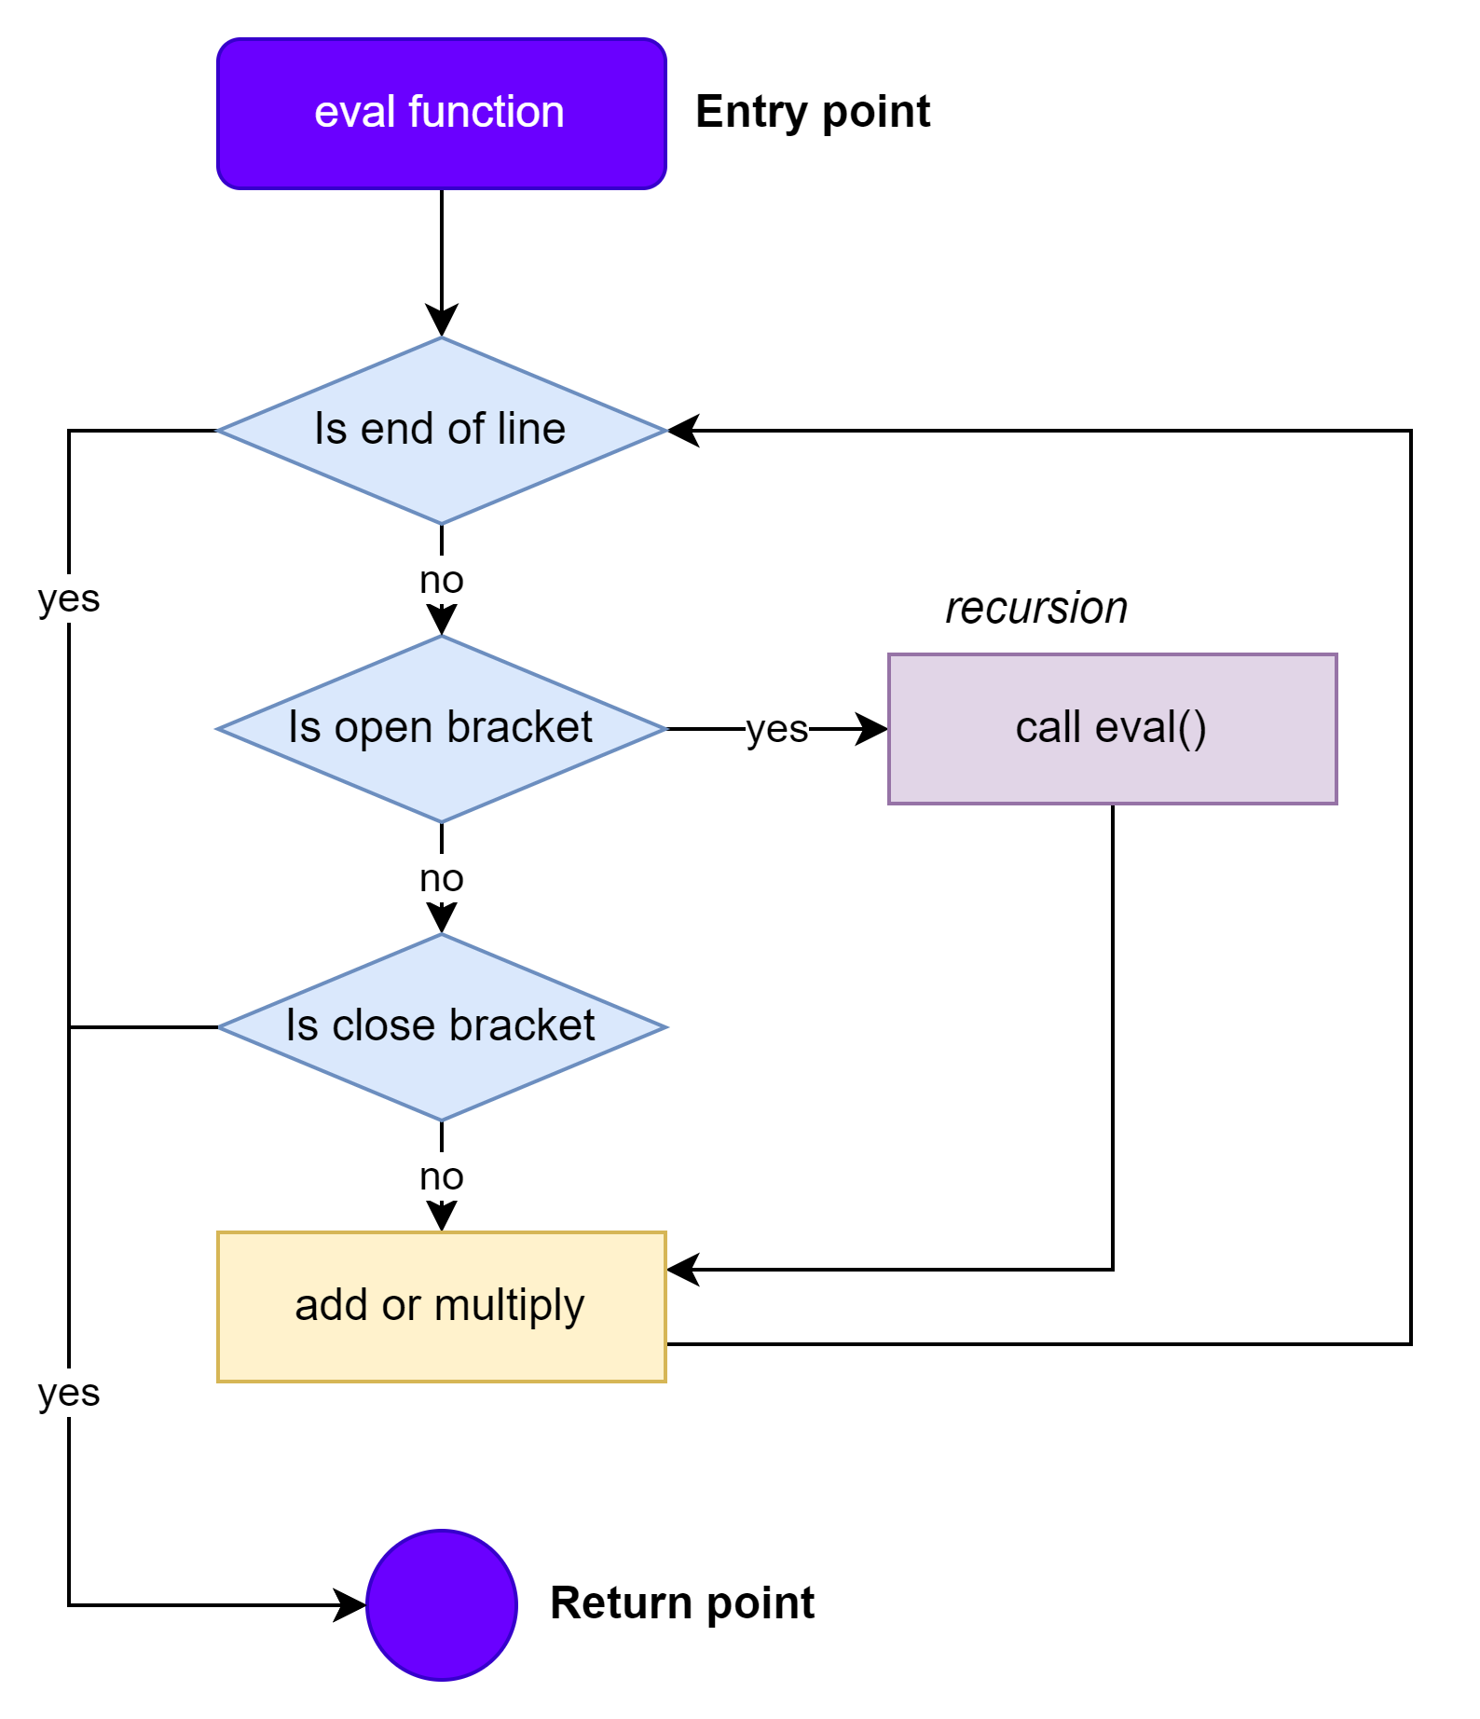
Bracket Sequence - Approach
Kattis. Bracket Sequence – Link
Use recursive function to evaluate the content
For even use ‘+’, for odd use ‘-’
Do not forget to apply modulo to avoid overloading
The task is nice to practice recursion and be aware about integer overflow.

Slide 5
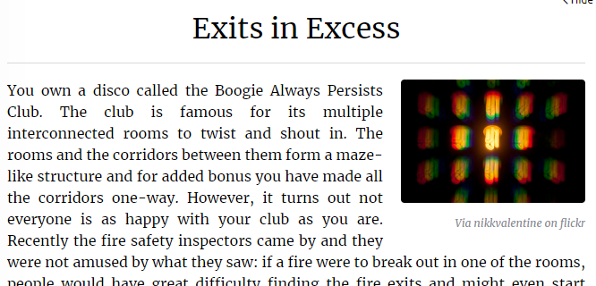
Exits in Excess
Kattis. Exits in Excess – Link

Slide 6
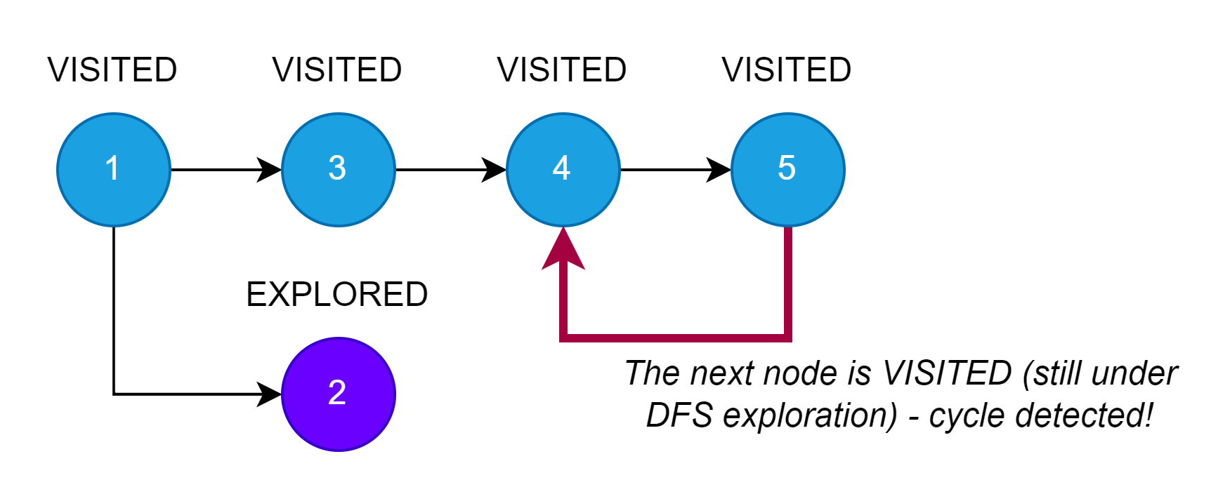
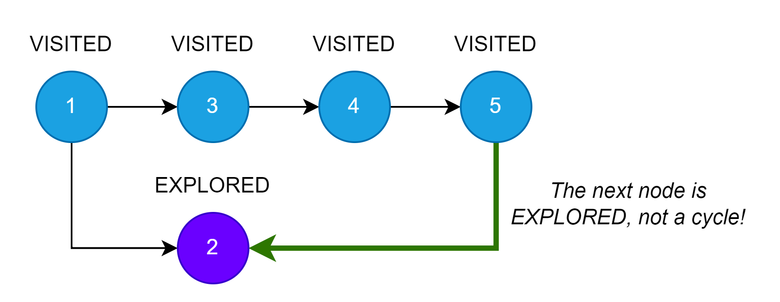
Exits in Excess - Approach
Kattis. Exits in Excess – Link
Naïve Approach (time limit exceeded):
Implement cycle detection algorithm based on DFS.
Eliminate connection as soon as edge forms cycle.
Despite time limit exceeded, it is nice to refresh or to know about cycle detection algorithm
Competitive Programming 4. Chapter 4.2.8. Cycle Check (Directed Graph)

Slide 7
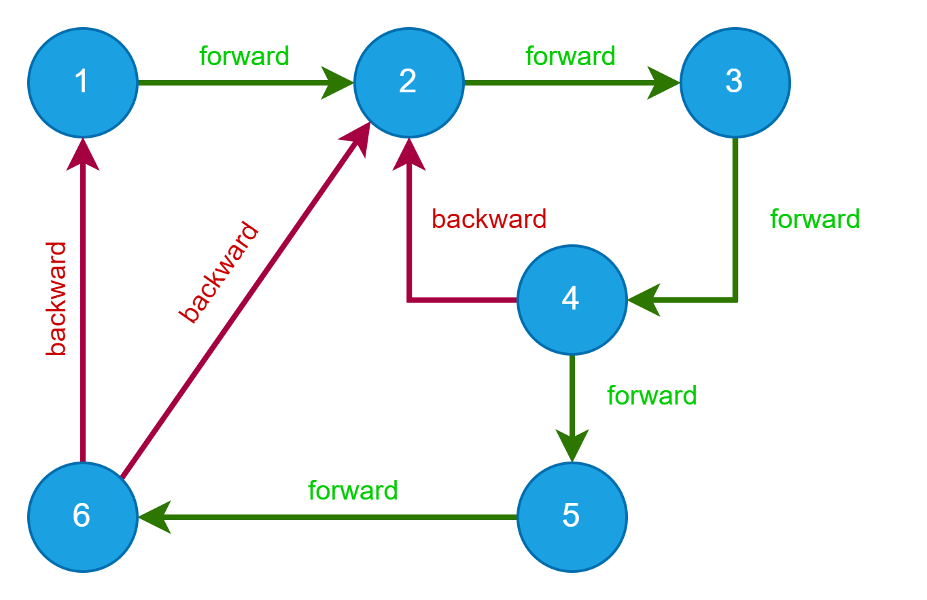
Exits in Excess - Approach
Kattis. Exits in Excess – Link
Acceptable Solution
Run DFS;
Count nodes whose ID is smaller than their unvisited neighbors (cnt_backward).
Count nodes whose ID is bigger than their unvisited neighbors (cnt_forward).
The answer is smallest count value: min(cnt_forward, cnt_backward)
The task only teaches you to be attentive. Almost no knowledge of algorithms is required.

Slide 8
Bracket Sequence – Implement?
Kattis. Exits in Excess – Link
Let's implement solution if auditory likes it.

Slide 9
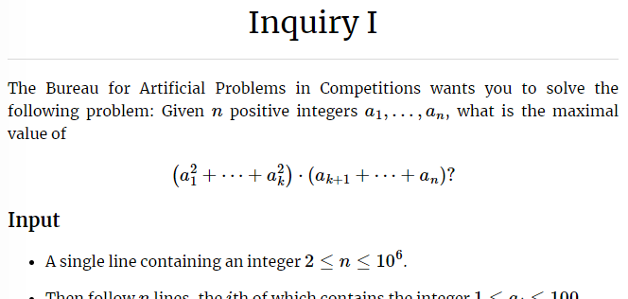
Inquiry I
Kattis. Inquiry I – Link

Slide 10
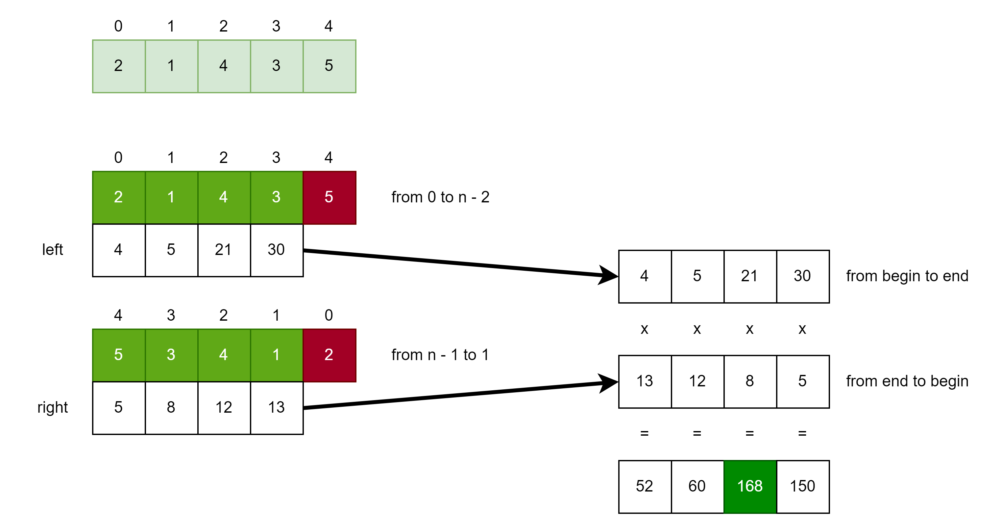
Inquiry I – Approach
Kattis. Inquiry I – Link
DP based approach
Count a₀^2 + a₁^2 + … + a_{n-2}^2
Count a_{n-1}^2 * a_{n-2}^2 * … * a₁^2
Element wise multiplication and find maximum

Slide 11
Inquiry I – Implement?
Kattis. Inquiry I – Link
Let's implement solution if auditory likes it.

Slide 12
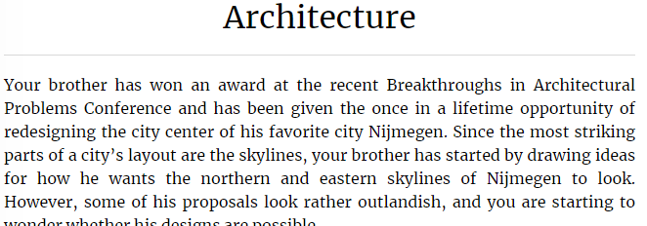
Architecture
Kattis. Architecture – Link

Slide 13
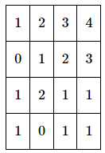


Architecture
Kattis. Architecture – Link
Very simple task. The answer: max(north) == max(east)
Can be rephrase as following: find a skyline point where the height is the same for north and east so that you can connect the plan.
Find max(north)
Find max(east)
Compare

Slide 14
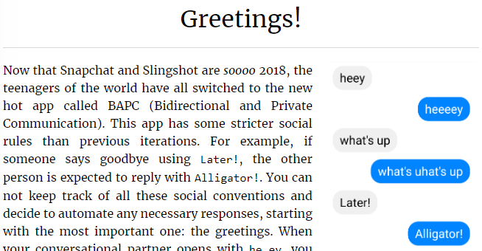
Greetings!
Kattis. Greetings! – Link

Slide 15
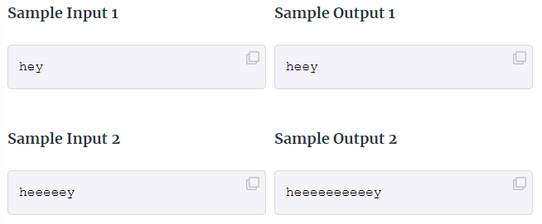
Greetings!
Kattis. Greetings! – Link
Very simple task.
If ‘e’, print it once more like in example below.

Slide 16
Hometask
Not very complex and not dull task:
Kattis. Hexagonal Rooks – Link
Look and try to solve other tasks from the contest: Link

Slide 17

How to Learn and Practice
As one of the recommendation is to use:
Book Competitive Programming 4
Kattis – Link
Online Judge – Link
LeetCode - Link
Few Theory
A Lot of Practice
A Lot of Theory
Almost No Practice

